Slide 1
Home In Tacoma Project
Tacoma Permit Advisory Taskforce
January 18, 2023
Notes:
STEVE -
Want to be clear about the timing/sequencing (fact sheet coming soon)
In 2024 – new rules in place

Slide 2
Meeting objectives and agenda
Home In Tacoma Project
Brief overview
Update on planning and engagement efforts
Developer engagement strategies
Permit Advisory Taskforce role
Key questions for the development community
Seeking input on interviewees for development assumptions vetting
Next steps
Set Taskforce topics
March (tentative) – Planning Commission preliminary concepts
April (tentative) – City Council District public meetings
Tracking state legislative housing discussions

Slide 3
Home in Tacoma as part of the Affordable Housing Action Strategy (AHAS)
AHAS Objectives
Objective 1: More homes for more people
Objective 2: Keep housing affordable and in good repair
Objective 3: Help people stay in their homes and communities
Objective 4: Reduce barriers for people who often encounter them
Home In Tacoma
Updating Tacoma’s housing rules to promote housing supply, choice and affordability
Residential zoning and standards
Affordable housing regulatory tools
Actions to support growth
Notes:
ELLIOTT –
Housing continues to be a top priority
We hear about housing needs regularly
Home In Tacoma – focuses on one very important part (our housing growth strategy)
But, does not stand alone (support for people experiencing house-lessness, renter assistance and protections, funding for affordable housing
Anti-displacement: Housing rules are very relevant

Slide 4
Home In Tacoma – Phase 1 Outcomes
Established a Middle Housing Growth Strategy
Comprehensive Plan goals and policies
Low-scale and Mid-scale Land Use Designations
Updated range of housing types and densities to be allowed in areas formerly designated for “single family detached dwellings”
Direction:
Expand tools to address affordability and anti-displacement
Evaluate public facility and service needs
Shift towards form-based codes
Notes:
ELLIOTT –
Very important to frame HIT Phase 2 in the context of what Council has already decided
“Not if we will support middle housing types, but how to get it right”
Council gave us a solid foundation with Phase 1
And, direction on what Phase 2 will accomplish (some specifics – MFTE, View study in East Tacoma…)

Slide 5
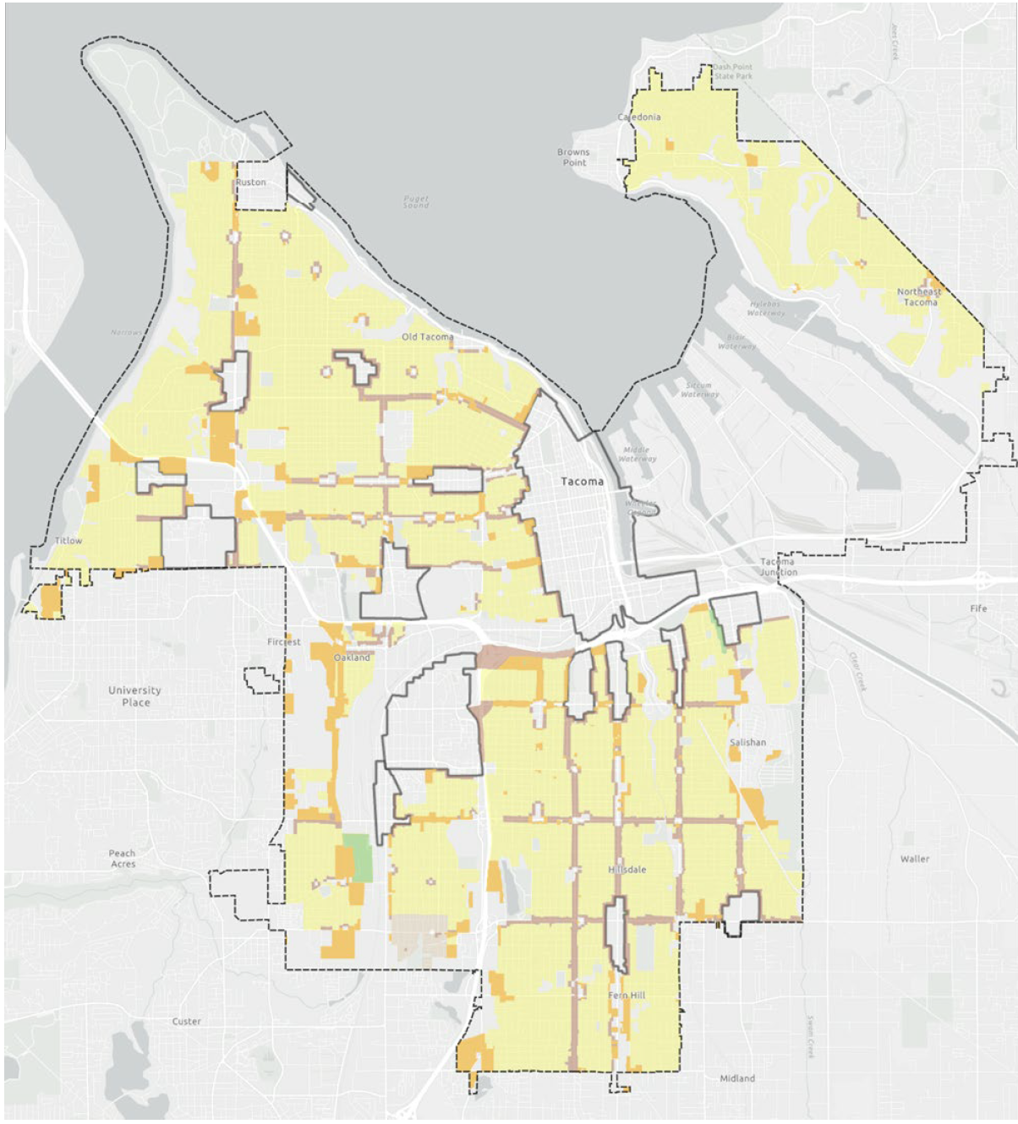
Zoning
Adopted policy direction
Missing Middle Housing (citywide, systematic approach)
Low-scale and Mid-scale areas
Housing types, number of units
Key decisions
How many zoning districts (what factors should inform this)?
How should zoning reflect neighborhood distinctions?
What should lot standards be (such as width, area)?
What should permit and notification processes be?
Notes:
Council gave strong foundation
Over the next couple of months, will focus on big picture: concepts for a zoning framework
At end of next round – a draft zoning map
Then – refinements, potential VSD expansion…
Ready for those neighborhood meetings

Slide 6
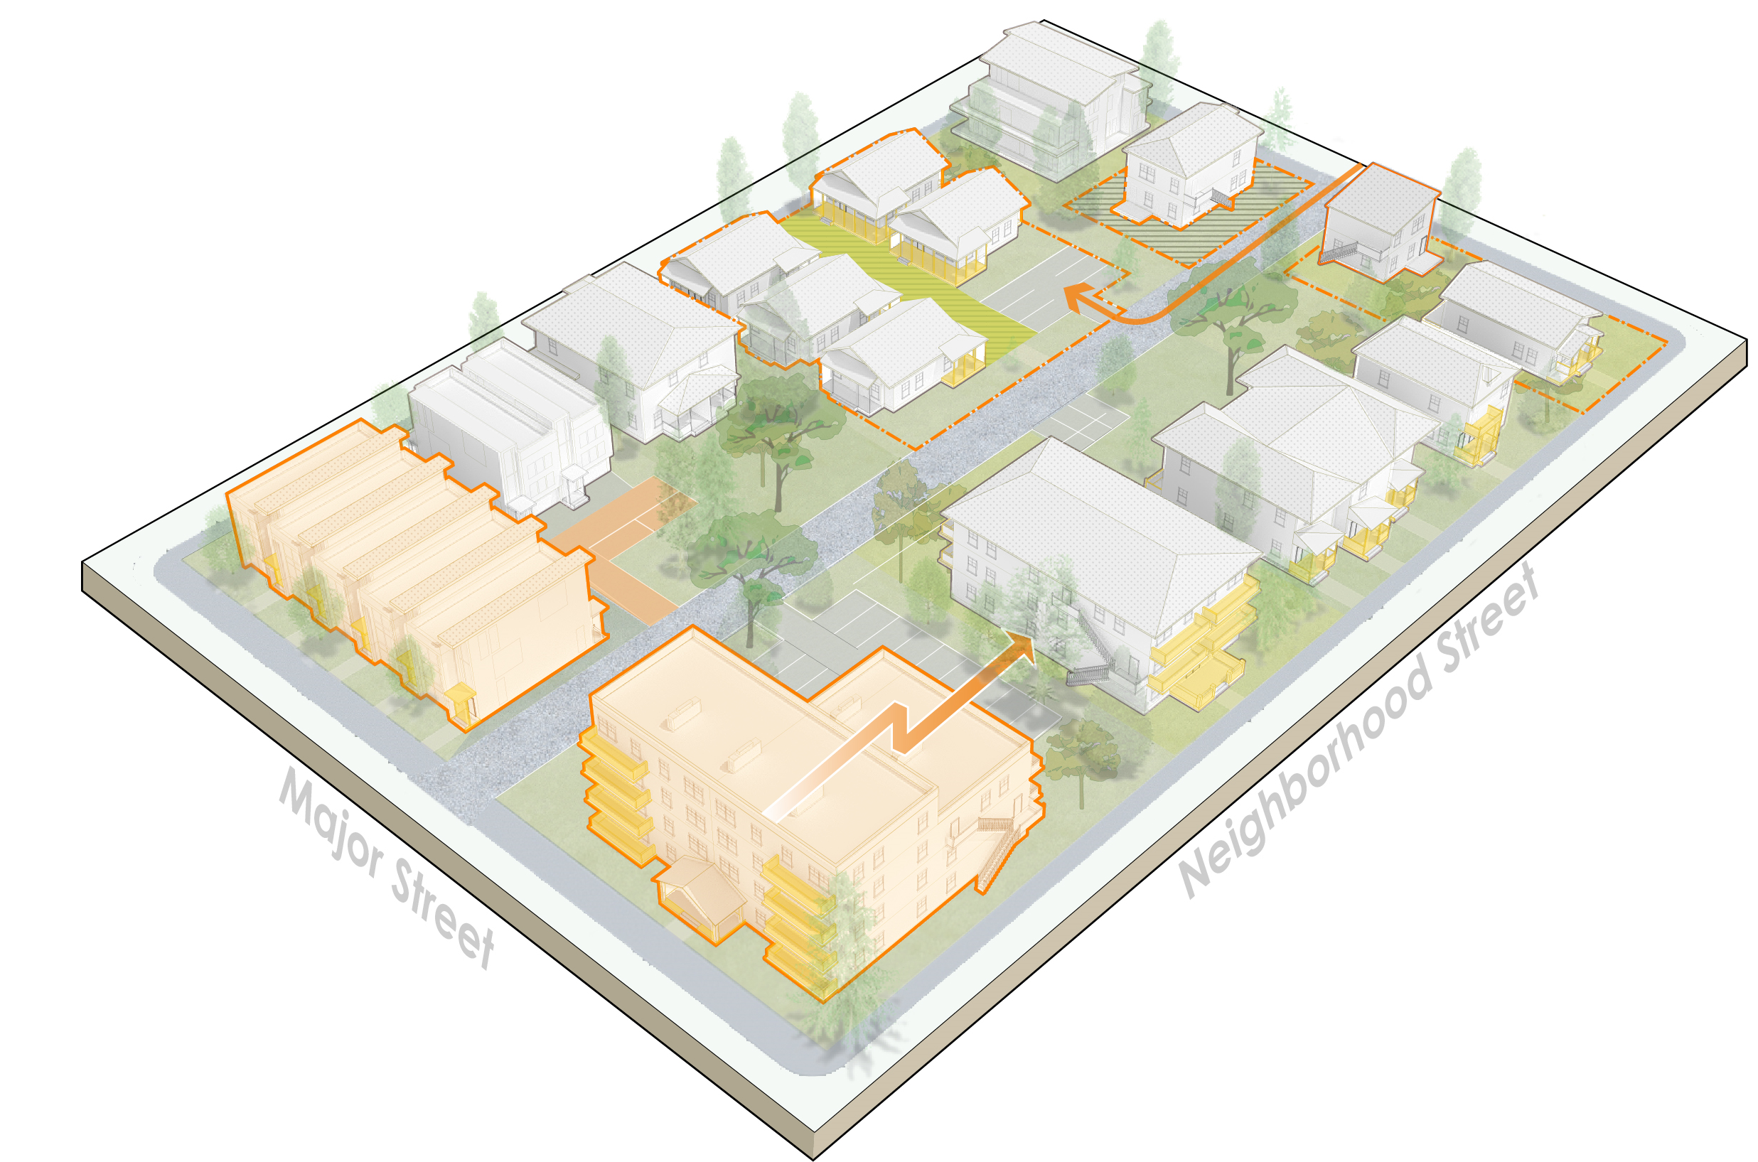
Standards
Adopted policy direction
Support middle housing development
Compatibility with residential patterns (such as building size, yards, access)
Meet multiple goals – affordability, choice, ownership, sustainability, accessibility, reuse and more
Infrastructure supports growth
Key decisions
How should we balance housing production versus other goals?
How can standards promote desired features?
What functional and feasibility considerations must inform standards?
How can infrastructure keep pace?
Notes:
Phase 1 direction
About priorities; balance….
Over the next couple of months-
Establish the big moves (such as – are we increasing tree requirements?; options to encourage reusing existing buildings? How big will new buildings be?)
There will be tradeoffs with housing development and cost
By the Mar-April neighborhood meetings will have a package to react to

Slide 7
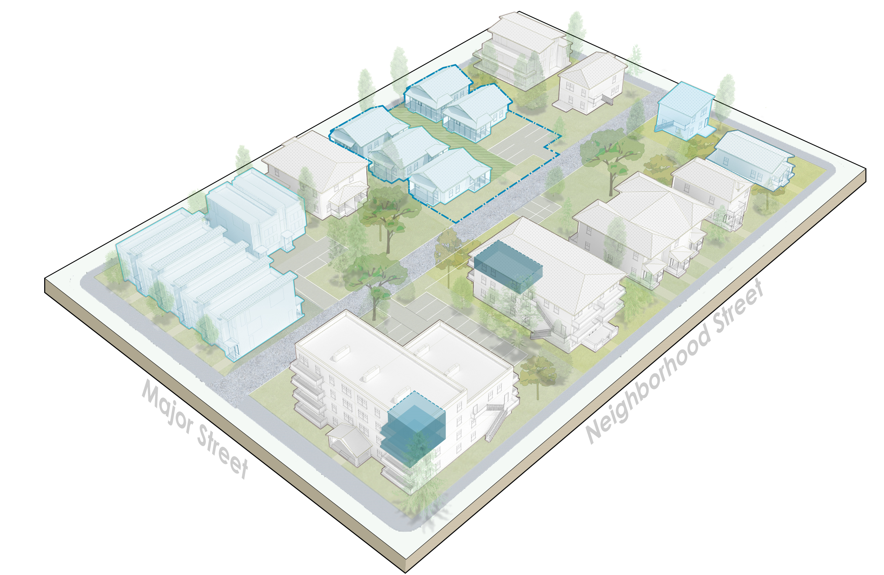
Affordability and Anti-displacement
Adopted policy direction
Calibrate standards to promote affordability
Strengthen regulatory affordable tools
Expand Multifamily Tax Exemption Program
Coordinated anti-displacement strategy
Key Decisions
Understanding the market – promote affordability without slowing construction
Setting priorities – location, households served, duration of affordable units
What incentives and bonuses make sense
Notes:
Phase 1 direction
How we write housing rules matters for how much housing gets built and affordability
Middle housing is important – but there will remain unmet need for affordable housing
Ownership opportunities
Decisions:
Over next couple of months – gathering input on tradeoffs (both for standards AND for specific affordability tools); using that to come up with big moves
One basic concept – incentives need to be valuable to developers (often that means allowing bigger buildings/more units)
By March-April:
At neighborhood meetings, share how those could play out
Refinements to the proposals

Slide 8
Project updates

Slide 9
Engagement Strategy
Not if but how to implement middle housing
Key topics are…
Middle housing design
Neighborhood infrastructure and amenities
Keeping housing affordable
Developer engagement
Tacoma Permit Advisory Taskforce
MBA, professional organizations
Affordable housing community
January and February 2023:
Housing Equity Champions applications (by Jan 27th)
Survey (by Feb 10th)
Environmental scope comments (by Feb 10th)
Interactive web forum (ongoing)
Developer engagement (ongoing)
Notes:
Education – help people to understand how decisions will affect housing goals and neighborhood change
Collaborative discussion
Developer engagement
Prioritize equity (hear from people who face housing challenges; belong to under-represented groups)
Get input that will be relevant
Hybrid
Neighborhood conversations
Big effort to get the word out

Slide 10
Existing Conditions Review
Reviews residential patterns in Tacoma’s neighborhoods
Lot sizes, housing mix, zoning, allowed heights
Alleys, intersection density, tree canopy
Block average characteristics (height, floor area ratio (FAR), lot coverage, setbacks, parking access)
Residential pattern areas (housing types, median parcel areas)

Slide 11
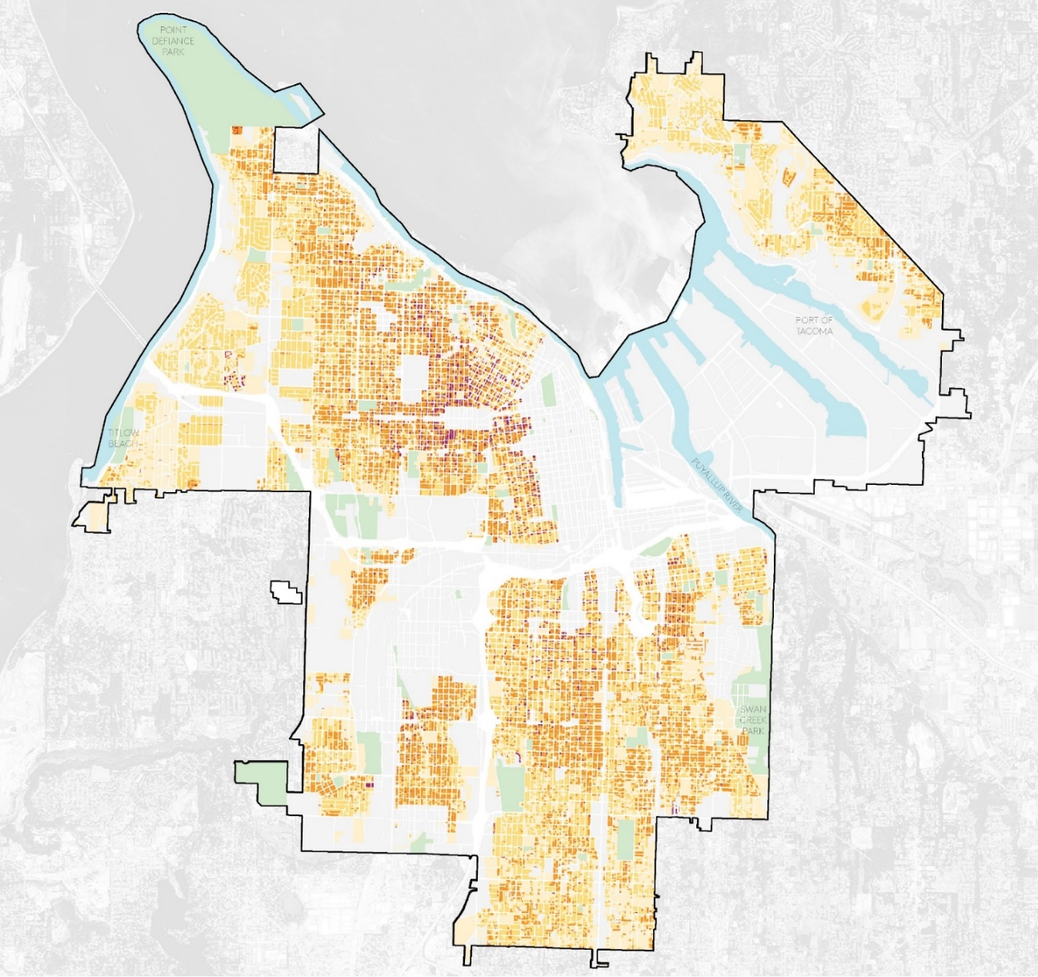
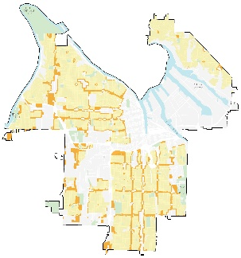
Existing Conditions - review of residential patterns (example)
Most parcels are 6,000 to 10,000 sq. ft. in size, which supports a wide mix of missing middle housing types.
^{COMMENCEMENT BAY}
Total number of parcels = 58,593
3,058 = Less than 2,000
3,329 = 2,000 – 4,000
17,017 = 4,000 – 6,000
27,296 = 6,000 – 10,000
7,893 = More than 10,000

Slide 12
Key Findings – Zoning Benchmarking Study
Looked at Portland, Spokane, Eugene and Kirkland
Middle housing zoning reform becoming more common
Many ways to combine zoning and standards to meet community priorities
Most cities use a hybrid Zoning Framework (form-based + density-based)
Most cities set min/max densities, except Portland which uses maximum building sizes
Cities had 4 to 6 “low-scale” Residential Zones, except Kirkland’s 19 zones
Most cities have consistent height limits across zones, except Eugene
Notes:
For example:
Spokane and Eugene created Housing Types with their own (sometimes identical) standards
Only Portland reduced Maximum Building Sizes

Slide 13
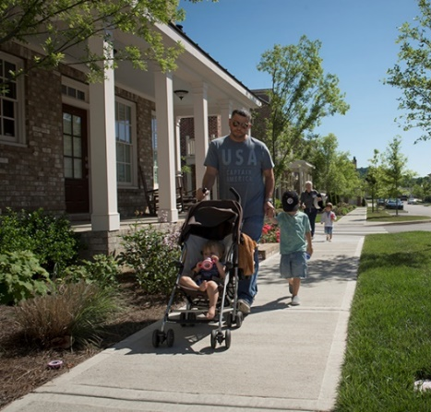
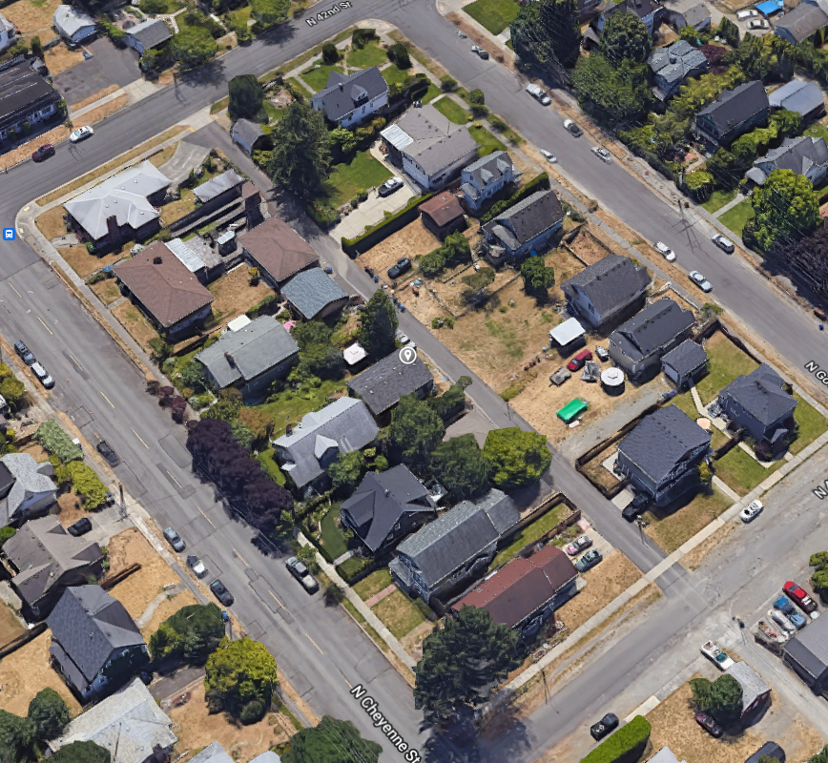
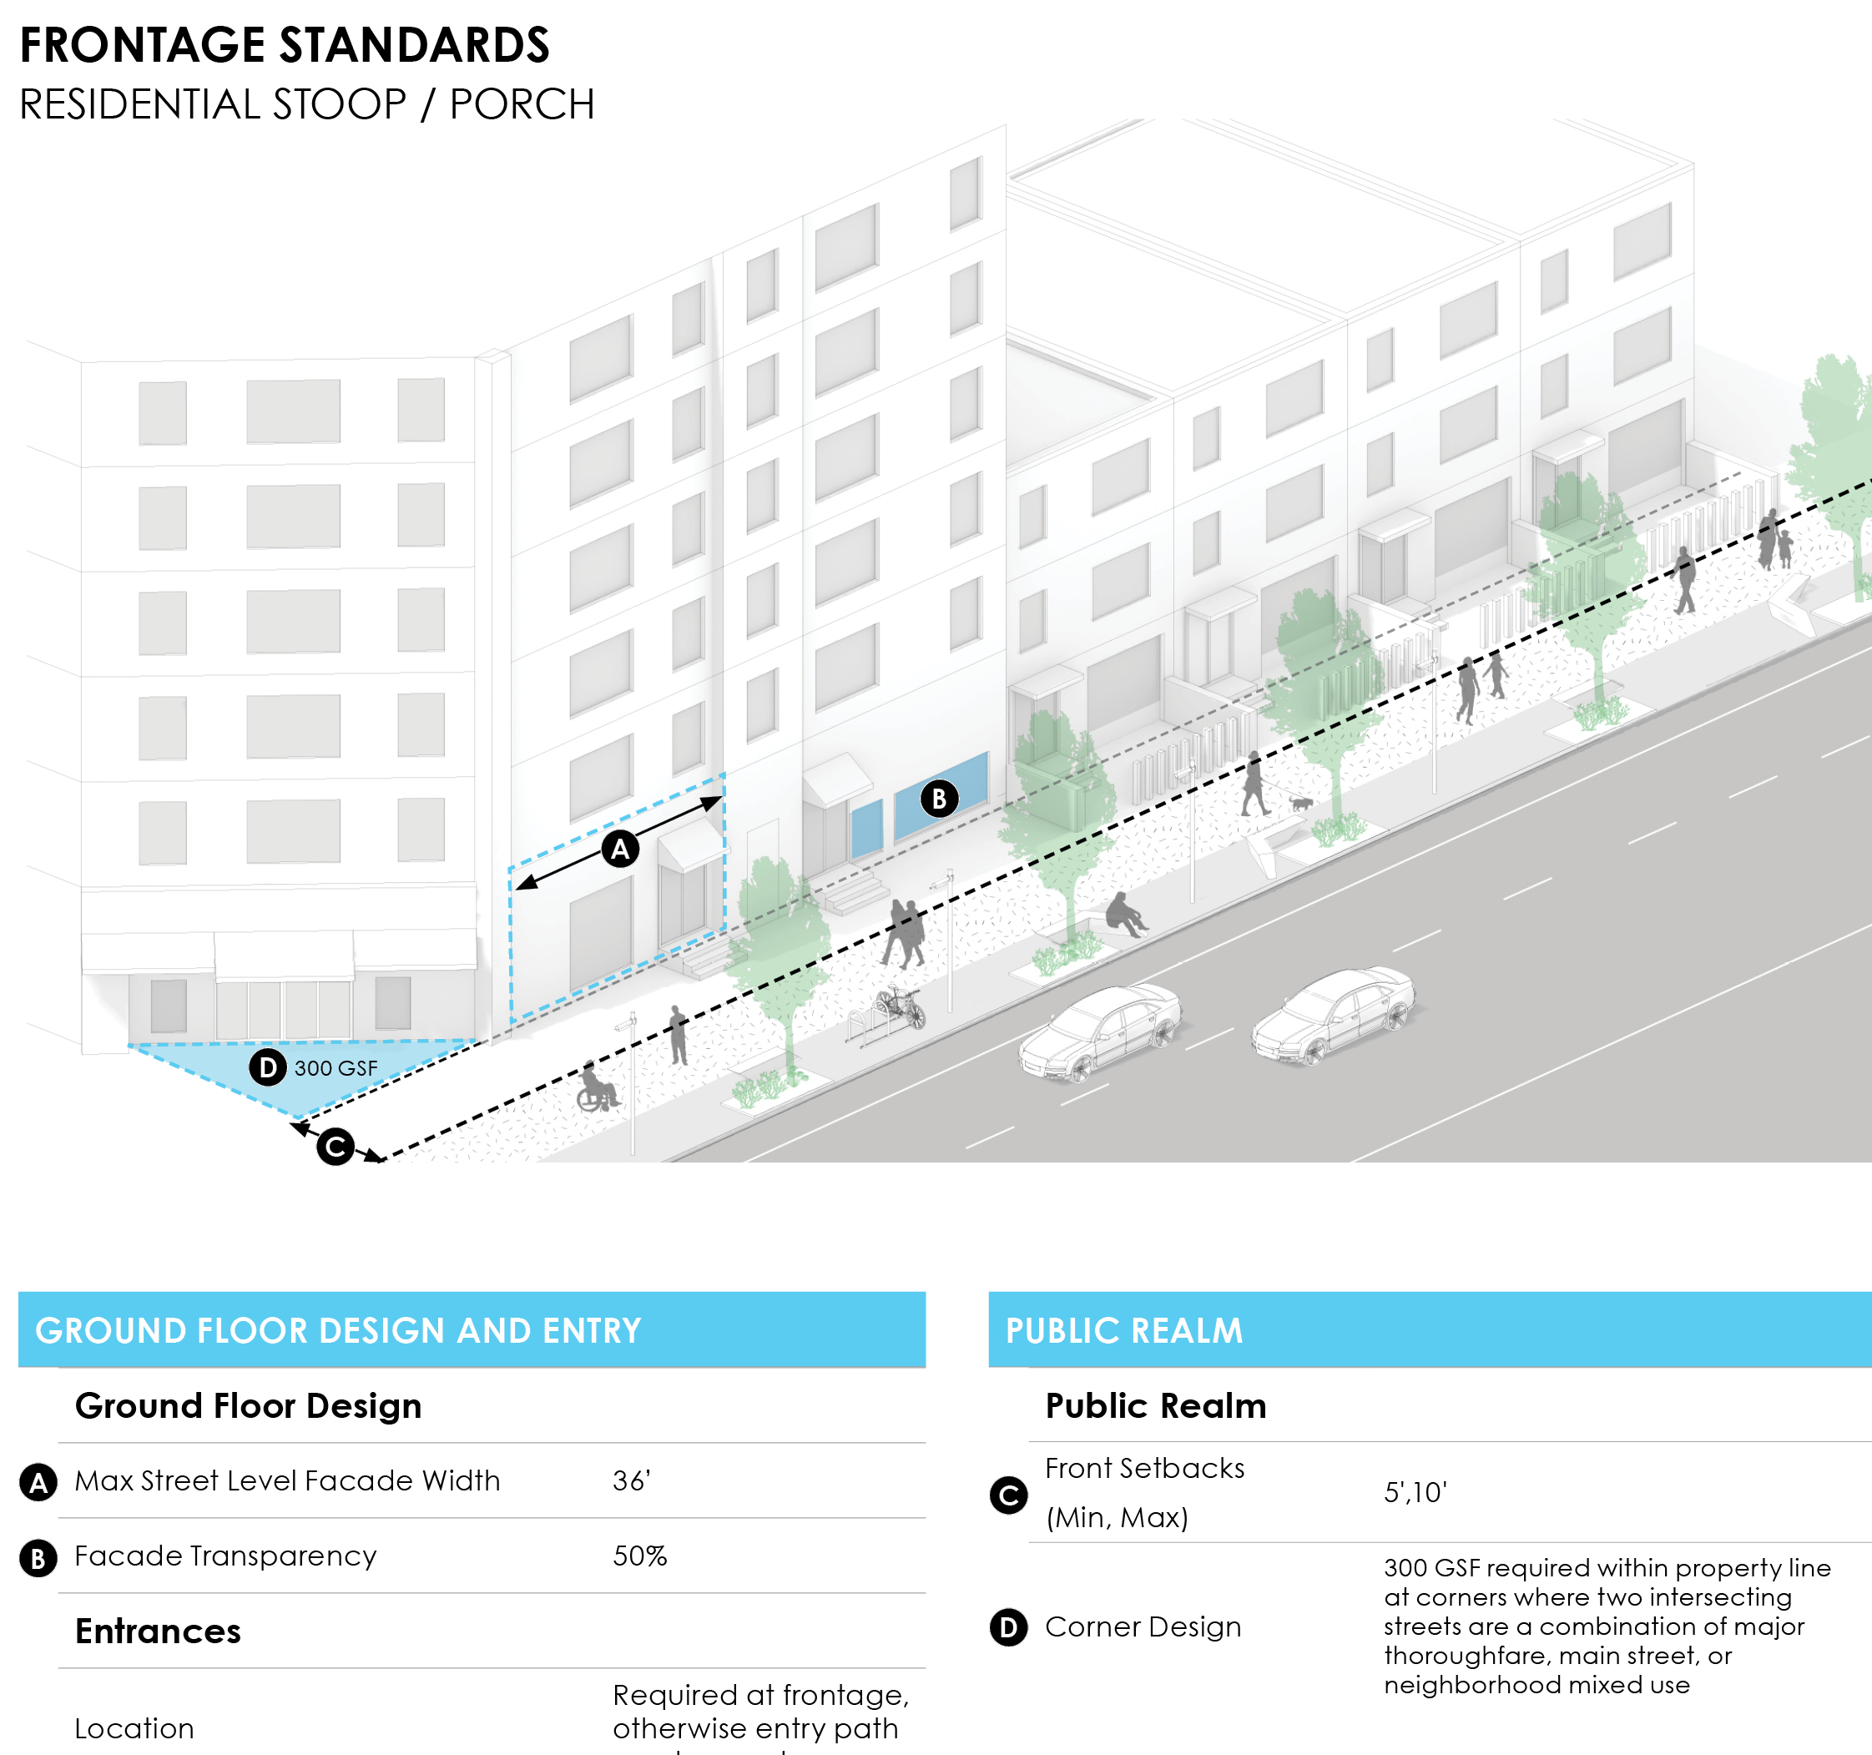
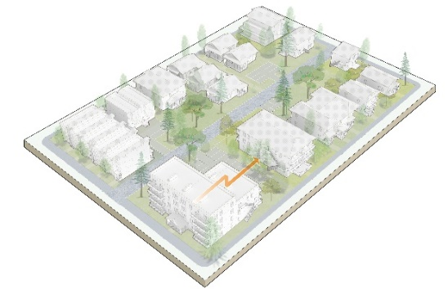
Zoning Framework and Map Options – Guiding Principles (GP)
GP #1
Meet Tacoma's newly adopted housing growth vision
GP #2
Use development scale as organizing characteristic​
GP #3
Continue to prioritize walkability, cycling, transit & “complete neighborhoods”
GP #4
Reflect
neighborhood
patterns such as yards, building
scale, height
​​​
GP #5
Create predictable, flexible regulations and requirements
​​​​
Notes:
Not choosing one over others; balancing them. Then going to do due diligence; how might these be whats not on this list (arch style):
Density/number of units;
Scale/intensity

Slide 14
Developer engagement strategies
Permit Advisory Taskforce roles
Key questions for the development community
Seeking input on interviewees for development assumptions vetting

Slide 15
Permit Advisory Taskforce roles
Facilitate development community engagement
Provide input on options
Make recommendations
TOPICS:
Zoning options
Middle housing development standards
Affordability and ownership strategies

Slide 16
Key questions for development community
Housing types: What housing types do you want to build more of? What housing types are undersupplied/in demand in Tacoma?
Home ownership: What barriers to homeownership models exist? Have you seen models in other jurisdictions that could work in Tacoma?
Parking: What parking ratios are marketable? How might this change based on the housing type (e.g., duplex, sixplex, 4-story multifamily?)
Barriers: Besides zoning, what barriers exist to constructing middle housing types (Building Code, financing, etc)?

Slide 17
Seeking input on interviewees for development assumptions vetting
ECONorthwest is conducting a development feasibility study
To vet their assumptions, seeking 4 developers (30-minute interviews):
Affordable housing focused developer (e.g., Habitat for Humanity)
Low-scale housing developer
Low-scale housing developer
Mid-scale housing developer

Slide 18
Home In Tacoma Project
Tacoma Permit Advisory Taskforce
January 18, 2023
Notes:
STEVE -
Want to be clear about the timing/sequencing (fact sheet coming soon)
In 2024 – new rules in place

